Slide 1
Simulation & Modeling CSE474
Project Showcase
Presented By:
Imran Hossain Imon
ID: 19101277

Slide 2
Project Title:
Signal Processing and Emotion Detection using EEG Signal with CNN and GCN

Slide 3
TABLE OF CONTENTS
01
02
03
Introduction
Methodology
Result
A brief description about the project
Data collection, Data Pre Processing, Feature Extraction, Model etc.
Result, Accuracy and Analysis

Slide 4
Introduction
01
A brief description about the project

Slide 5
Introduction
Emotion Detection
1
2
Using EEG Signals
Hybrid Convolutional Network
3
4
Classifying the Emotion

Slide 6
Methodology
02
How I’ve done the project

Slide 7
Methodology
Data Collection
Feature Extraction
Step 02
Step 04
Step 01
Step 03
Signal Processing
Proposed Model

Slide 8
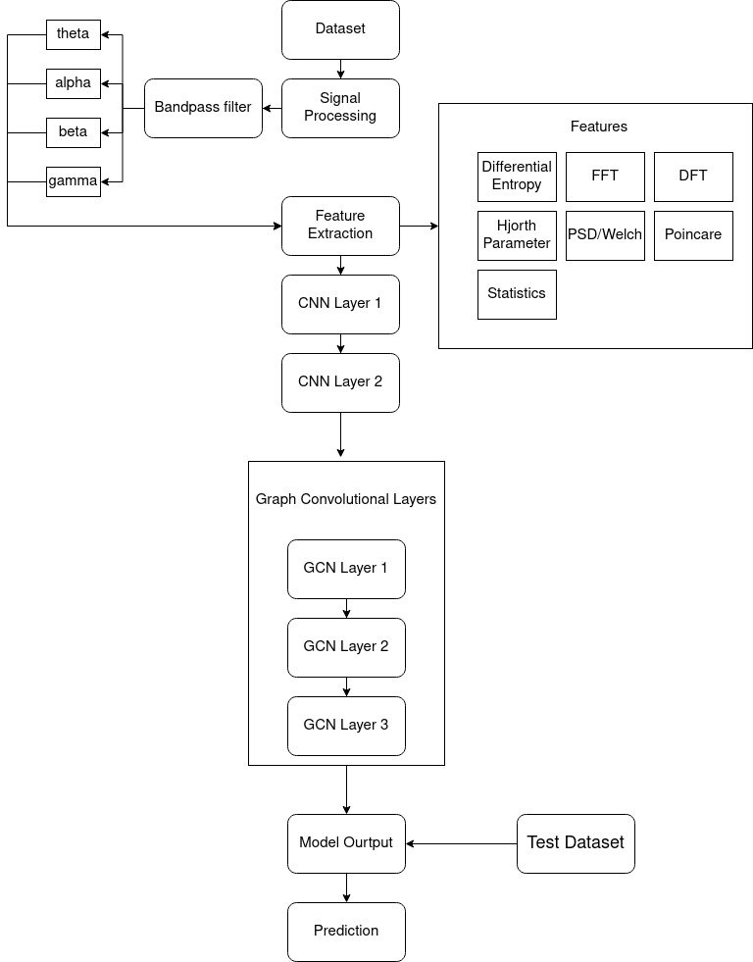
Workflow

Slide 9
Dataset
Dreamer
Gameemo
14 Channel EEG and 128Hz ECG Signal
23 Subject
18 Emotional Video Clips
14 Channel EEG and 128Hz ECG Signal
14 Subject
Played 4 types of Video Games

Slide 10
Signal Processing
Frequency Range: 4-50 Hz
Band-Pass Filtering
Filtered Frequency Band
For Emotion Detection frequency range is 4-50 HZ required.
To remove frequency under the low pass and high pass frequencies.
Theta band (4-8 Hz), alpha band (8-13 Hz), beta band (13-3- Hz), gamma band (30-50 Hz)

Slide 11
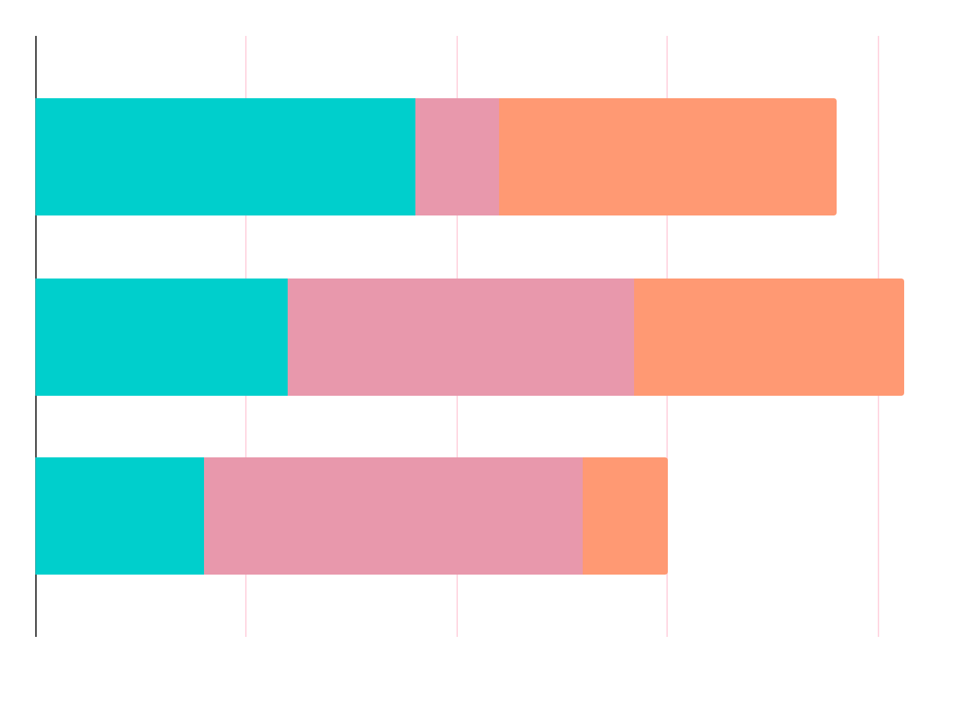
Feature Extraction
FFT
Differential Entropy
Hjorth Parameter
Convert Time domain signal to Frequency Domain Signal
Measure the randomness in continuous variables
Statical analysis to find activity, mobility and complexity
Statistics
For some statistical analysis like Max, Min, Mean etc.

Slide 12
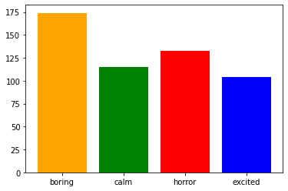
Proposed Model
1D CNN
For feature extraction process as it takes data from input and it has less computational complexity
Graph Convolutional neural Network (GCN)
Message passing technique, Node optimization, Node embeddings.

Slide 13
Result & Conclusion
03
Resultt and Discussion

Slide 14
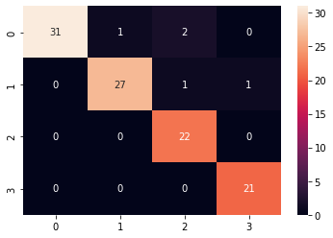
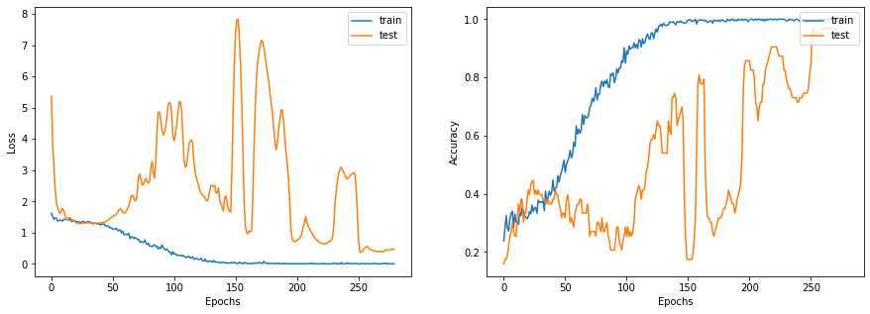
Result

Slide 15
Conclusion
Better Accuracy
Future work can be generated Emoti0nal Signal and Multi class classification

Slide 16
—SOMEONE FAMOUS
“This is a quote. Words full of wisdom that someone important said and can make the reader get inspired.”

Slide 17
Thank You

